Slide 1
Hydra
Automated Plant Watering System

Slide 2
What is Hydra?
Is a microcontroller-based automatic plant watering system.

Slide 3
Hydra Modules
Hydra Root Module and the Hydra Leaf Module

Slide 4
Hydra Root Module
The Hydra Root Module controls the overall management of the Hydra Network including all connected Hydra Leaf Nodes.

Slide 5
Hydra Leaf Module
The Hydra Leaf Module controls the specific branch. It is responsible in checking the soil moisture and request to the Hydra Root for a water distribution.

Slide 6
Features

Slide 7
Hydra Features
Automated watering based on user preferences such as time-based watering or when the soil is dry.
Upgradable up to 16 independent on-field watering modules.
Automatically detect the water level in the tank and initiates a refill process.
Hydra Leaf is battery-powered that could run approximately 14 days to 31 days based on battery capacity.
Data logging feature.
Able to compute water consumption from different connected Hydra Leaf and adjusts automatically based on its consumption.
Sends a text message to the user of system activities based on user preferences.

Slide 8
Water Distribution Setup
Water Distribution Setup is based on the pump configuration either discharge only, no pump attached, discharge-refill configuration or either of the three.

Slide 9
Legend
Water Valve
Water Flow Sensor
Water Drip/ Atomizer
Hose/ Water Line
Water Flow Direction
Optional Water Line

Slide 10
Discharge Only
Field Lines
Branch Line
Distribution Line
Source
Pump
Source
Line
Tank-based
Stable Main Water Source Pressure
Pump is configured for water discharge purposes only
Drain is optional
Best suited for having a stable main water source water pressure esp. those with connections from the water district.
Tank
Drain
Line
Drain

Slide 11
Direct Distribution
Field Lines
Branch Line
Distribution Line
Pump
Source
Source
Line
Unstable Main Water Source Pressure
Pump is configured for water discharge purposes only
Applicable only to main water source such as well.

Slide 12
Discharge-Refill
Field Lines
Branch Line
Distribution Line
Source
Line
Pump
Source
Discharge
Line
Discharge
Line
Tank-based
Able to switch from direct source distribution, tank refill and tank-based water discharge.
Drain is optional.
Suitable for either stable and unstable water source pressure.
Tank
Drain
Line
Drain

Slide 13
Components

Slide 14
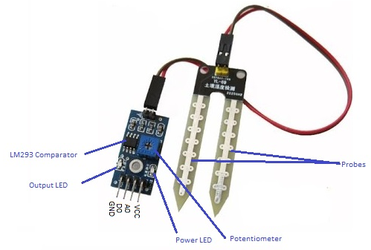
Soil Moisture Sensor
Features:
Digital and analog output
Working voltage: 3.3V-5V On-board LM393 chip
Dimension: 3.2cm * 1.4cm
Price: Php. 55

Slide 15
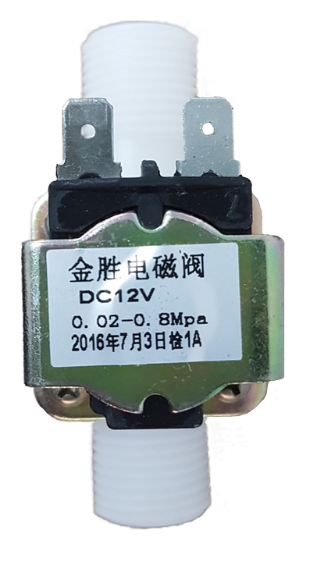
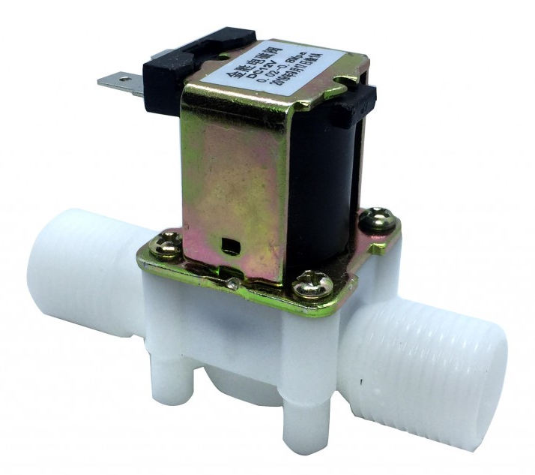
Plastic Water Solenoid Valve
Features:
½ inch diameter PVC pipe
12V powered
Minimum pressure requirement of 0.02 Mpa (3 PSI)
Price: Php. 250

Slide 16
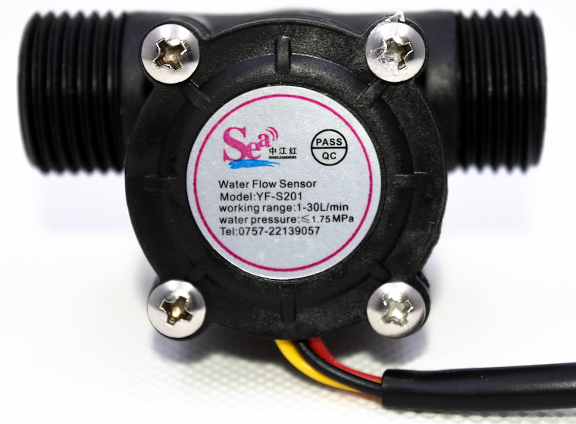
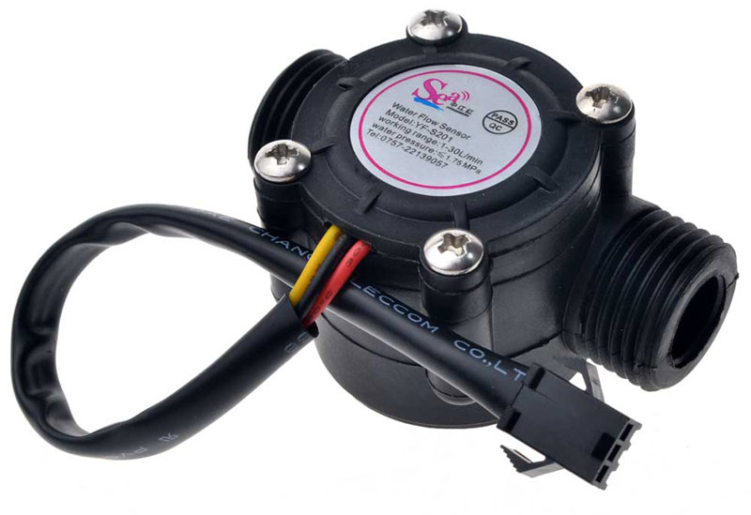
Plastic Water Flow Sensor
Features:
½ inch diameter PVC pipe
5V - 12V powered
13.1 (L/min) output readings
Price: Php. 247

Slide 17
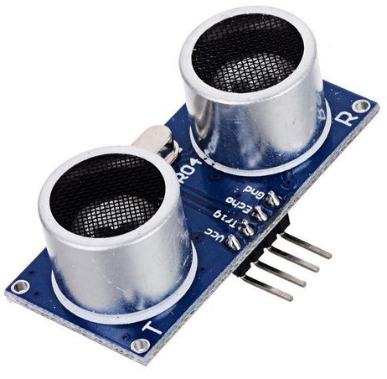
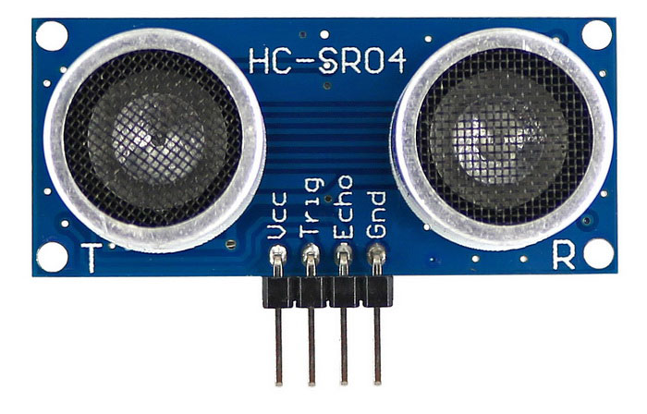
Ultrasonic Ranging Sensor
Features:
½ inch diameter PVC pipe
5VDC powered
Effective angle for computation: < 30 degrees
Ideal distance: 2cm to 500 cm
Ultrasonic Frequency: 40k Hz
Price: Php. 60

Slide 18
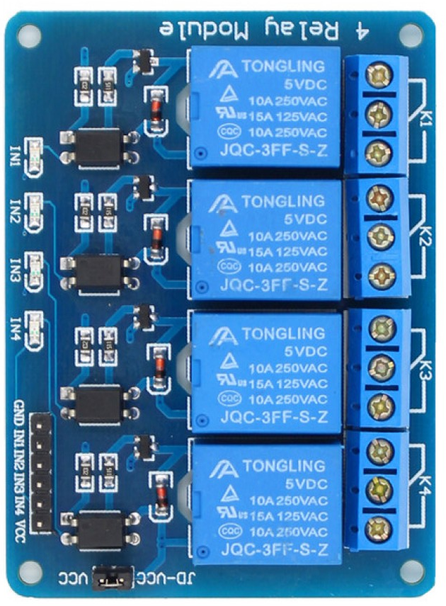
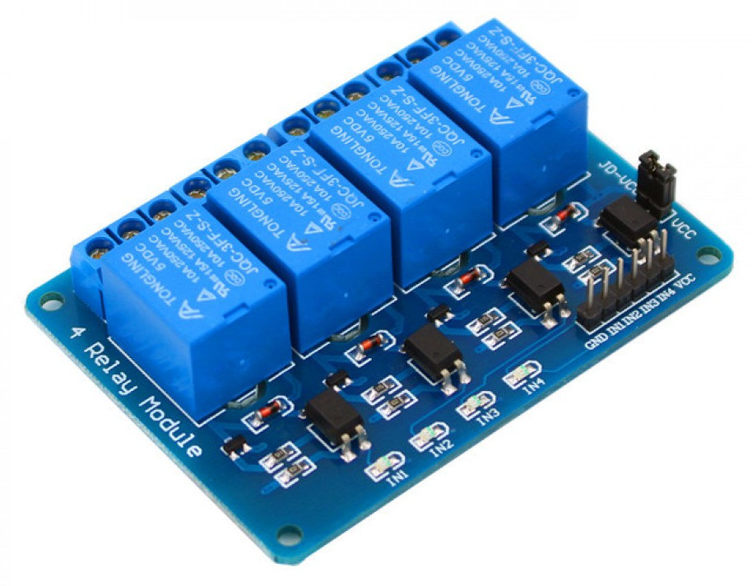
Relay Module
Features:
Power output: 250V AC 10Amps/ 125V DC 10 AMps
5V DC low level trigger
16-channel relay variation
Price: Php. 155 (4-channel)

Slide 19
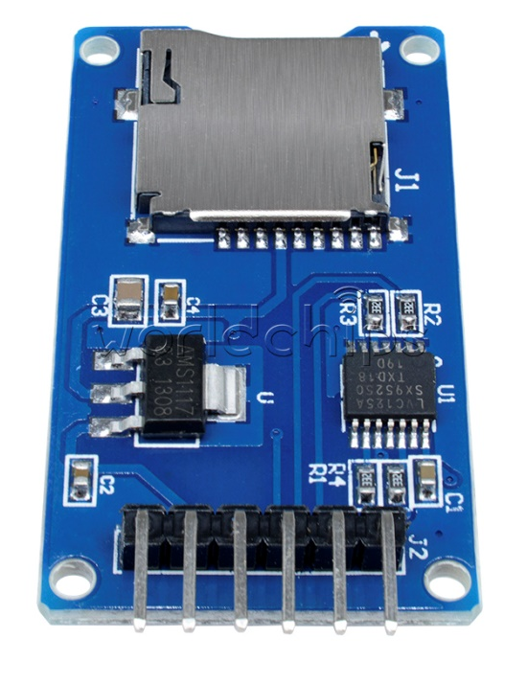
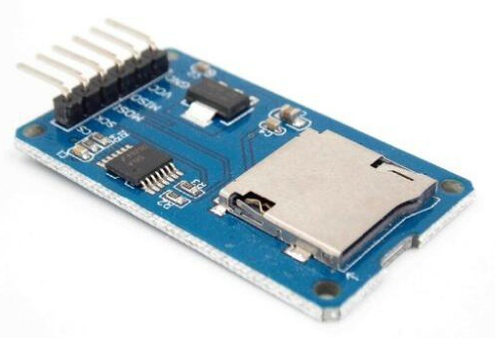
MicroSD Card Reader Module
Features:
Supports Micro SD cards, Micro SDHC card (high speed card)
Price: Php. 79

Slide 20
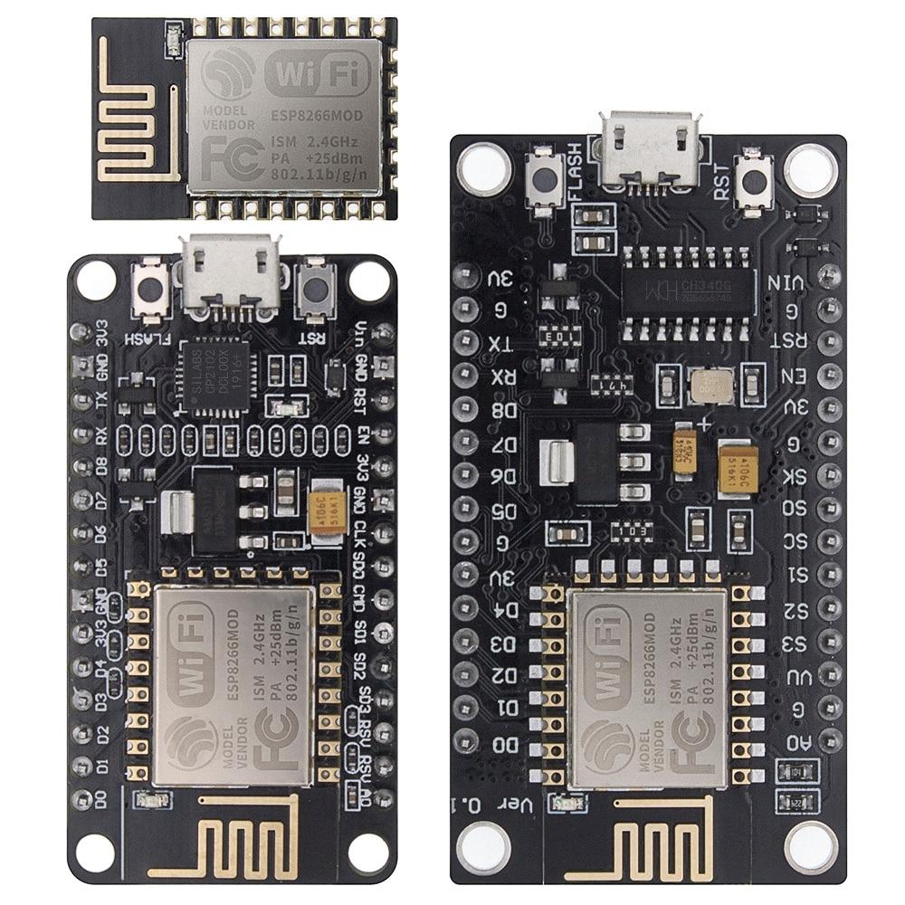
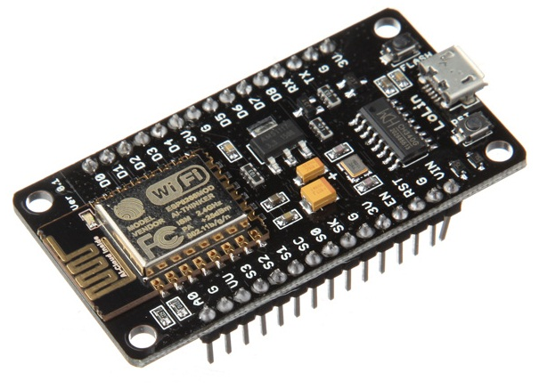
NodeMCU V3 ESP8266 ESP-12E
Features:
Communication interface voltage: 3.3V.
Antenna type: Built-in PCB antenna is available.
Wireless 802.11 b/g/n standard
WiFi at 2.4GHz, support WPA / WPA2 security mode
Power input: 3V
Range: ~250 meters
Price: Php 160

